Slide 1

MOBILE PHONE JAMMER Estimated deadline – 06/02/2022

Slide 2
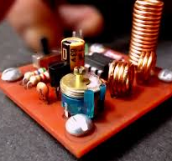
The device made will block the signal from the tower that the mobile generally receives. This will be done by using the frequency of the signal generated by 555 timer.

Slide 3
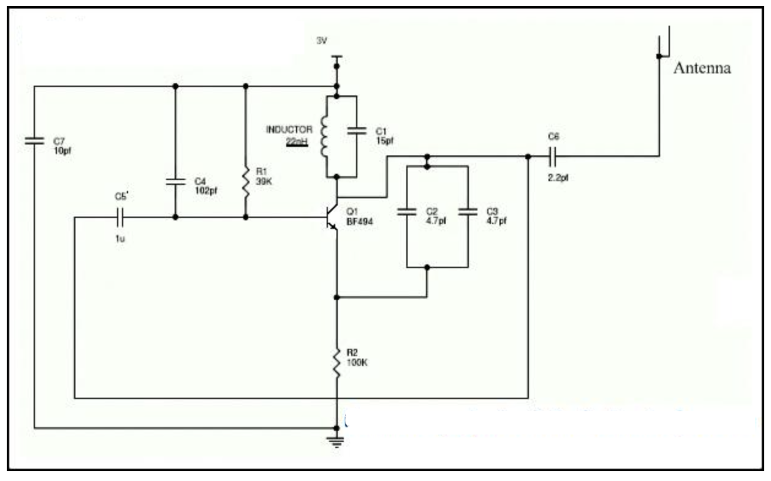
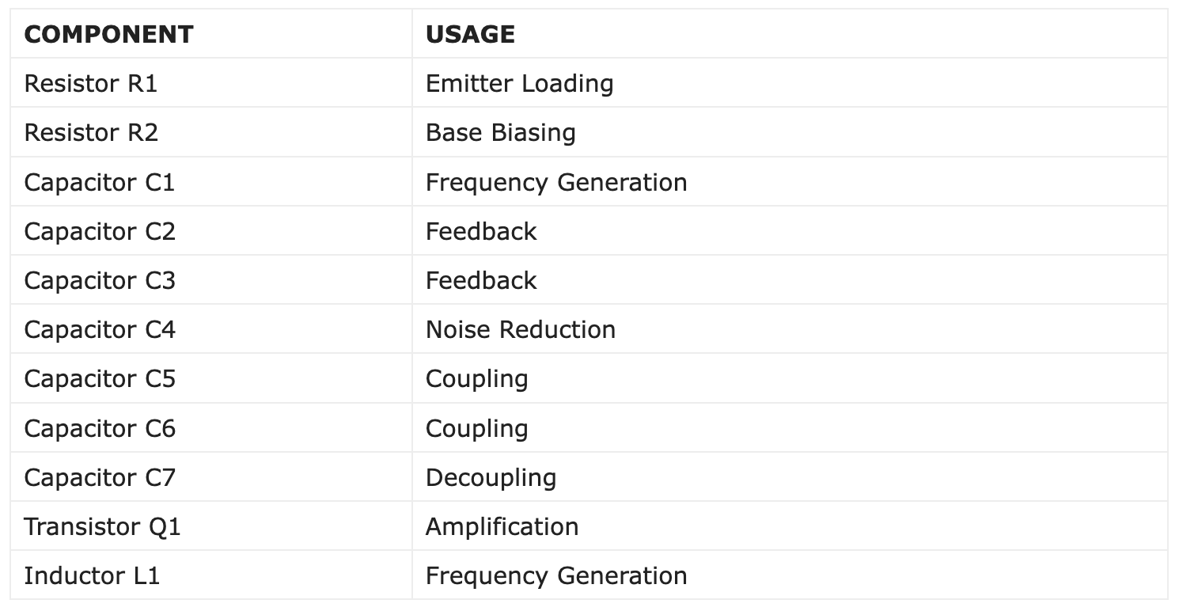
Circuit Diagram

Slide 4
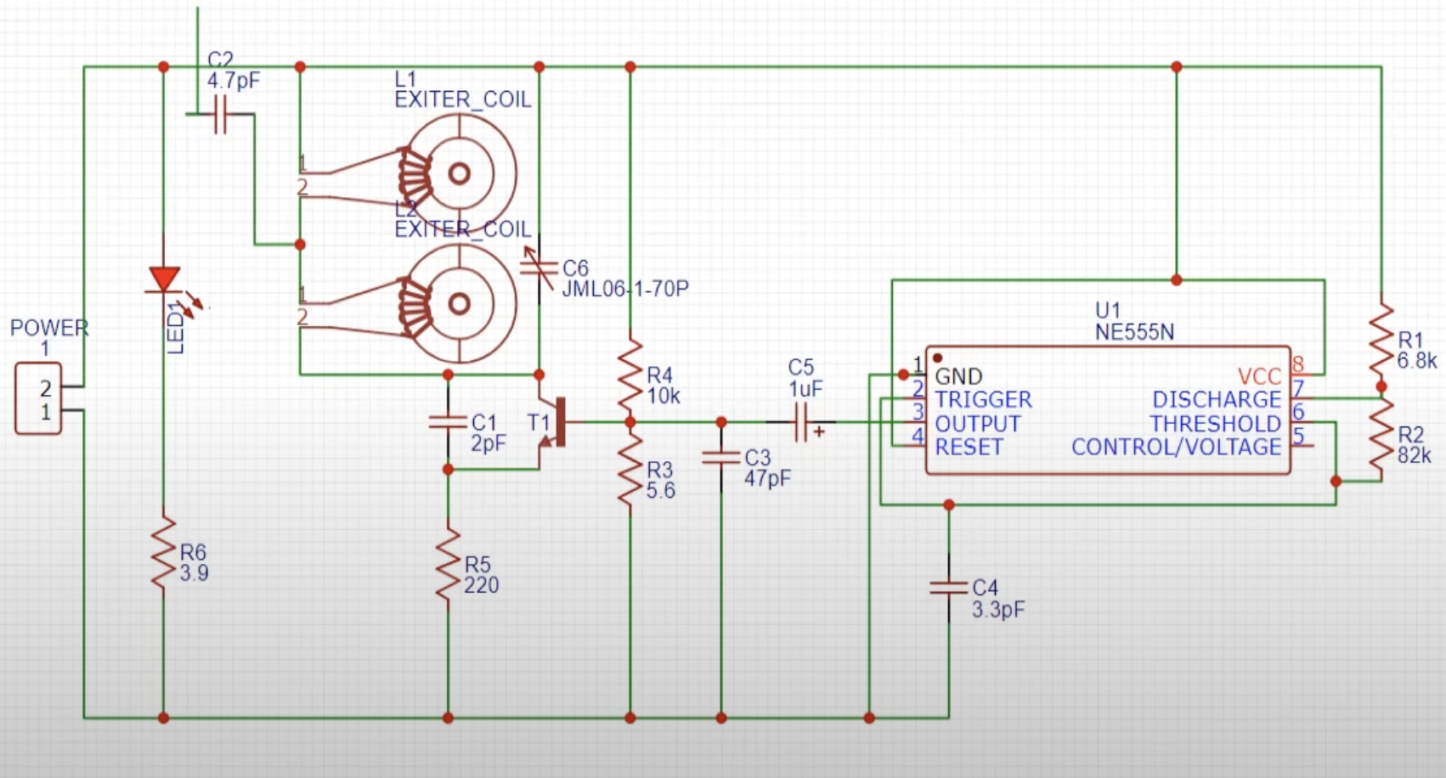
Improved Circuit Diagram

Slide 5
Components Required
NE-555 timer IC –1
PCB Board
NE-555Timer IC Holder – 1
BF495 IC – 1
1-30PF Timmer(variable capacitance) - 1
Slide Switch – 1
Power Connector
LED – 1
Copper Wire
Battery

Slide 6

Application of BF495 IC:
BF495 is an NPN transistor. It is a medium frequency transistor designed to use in RF and radio applications. The first pin of the transistor is base, second is emitter and third is collector.
Where We Can Use It & How to Use:
As mentioned above BF495 is primarily designed or radio and RF applications and can be used in variety of this type of applications such as High frequency circuits is televisions and radios, FM Radios, AM Oscillators of low noise type, IF amplifiers etc. But it can also be for audio amplification purposes and other general purposes.

Slide 7
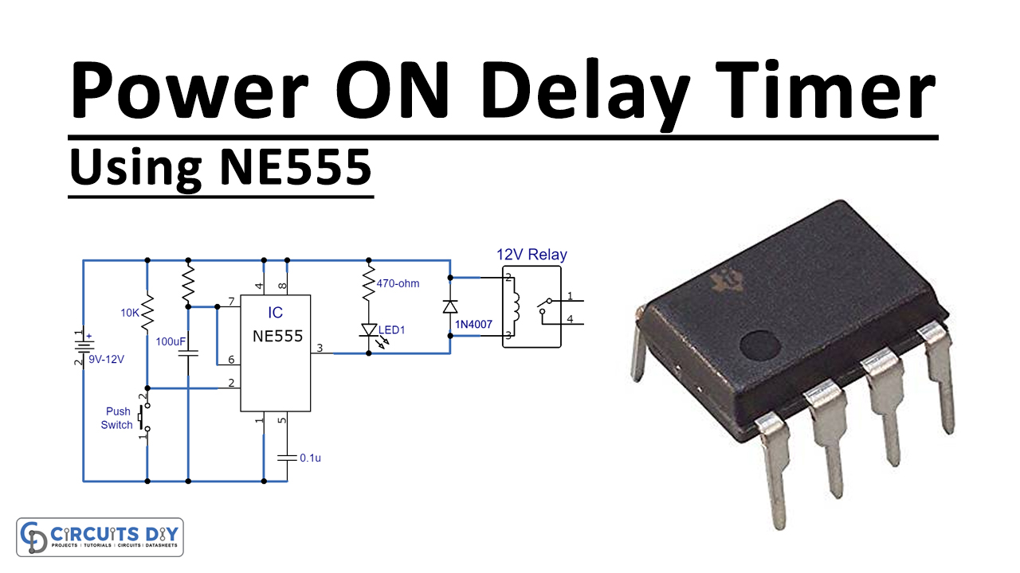
Application of NE-555 Timer IC:
555 timer is one of the most important integrated circuits used in digital electronics. Some common uses and application of 555 timer IC are as follow:
Duty Cycle Oscillator
To provide Accurate time delays
As a flip-flop element
Quad Timer applications
Pulse, Waveform, and square wave generation
It can be used as monostable multivibrator and astable multivibrator
DC Voltage Regulators
Voltage to Frequency Converter
Frequency Divider
Schmitt trigger
Pulse detector
Wiper speed control
Timer Switch
Time delay generation, precision timing and sequential timing

Slide 8

Timeline
We are expecting to complete the time project within 2 weeks of time i.e. 6/2/2022.
Keeping in mind our end semester exams.

Slide 9

Team Name – Aryaman & Dikshant
Made By - Dikshant

